Slide 1
Agentic Career Counseling Companion
IBM HACKATHON PROJECT
Presented By: Abhay
Student name : Abhay Singh Thakur
College Name & Department : Takshshila Institute of Engineering and Technology, Computer Science Engineering

Slide 2
OUTLINE
Problem Statement
Technology used
Wow factor
End users
Result
Conclusion
Git-hub Link
Future scope
IBM Certifications

Slide 3
Problem Statement
Students often struggle to make informed career decisions due to fragmented access to guidance, limited self-awareness of academic strengths, and rapidly evolving industry landscapes. Traditional counseling methods lack personalization and scalability, leading to missed opportunities and career mismatches. The challenge is to develop an intelligent, autonomous agent that continuously monitors student performance, evolving interests, and real-time labor market trends to deliver tailored career pathway suggestions. This would empower students to make confident, future-ready decisions with minimal dependency on manual intervention.

Slide 4
Technology used
IBM cloud lite services
Natural Language Processing (NLP)
Retrieval Augmented Generation (RAG)
IBM Granite model

Slide 5
IBM cloud services used
IBM Cloud Watsonx AI Studio
IBM Cloud Watsonx AI runtime
IBM Cloud Agent Lab
IBM Granite foundation model

Slide 6
Wow factors
The agent tailors its advice based on each student’s interests, strengths, academic background, and career goals. It asks thoughtful, respectful questions to better understand the individual, avoiding generic, one-size-fits-all suggestions.
With IBM Granite's advanced AI capabilities, the agent not only suggests careers but also explains why they’re a good fit. It adapts to the student’s evolving interests through smart, interactive conversations
The assistant maps clear learning journeys for students, including recommended courses, certifications, internships, and soft skill development. It guides them from where they are now to where they want to be.
Designed to honor student choice, the agent respects cultural backgrounds, personal ambitions, and non-traditional career aspirations like entrepreneurship or creative arts. It empowers students, not pressures them.
The AI recognizes not just academic performance but also soft skills like creativity, leadership, and communication—helping every student find a path where they can thrive.
Available 24/7, the agent offers consistent support to students without depending on human counselors. It can scale across schools and regions, helping large student populations effectively.
This AI grows with the student. It updates its suggestions as interests shift or goals become clearer, offering fresh, relevant guidance every time.
With a warm, mentor-like tone, the assistant keeps students engaged and inspired. It supports them through uncertainty and helps them explore options confidently.

Slide 7
End users
Students (Primary End Users)
School & College Counselors / Educators
Educational Institutions / Administrators
Parents and Guardians
Career Coaches / Private Counselors

Slide 8
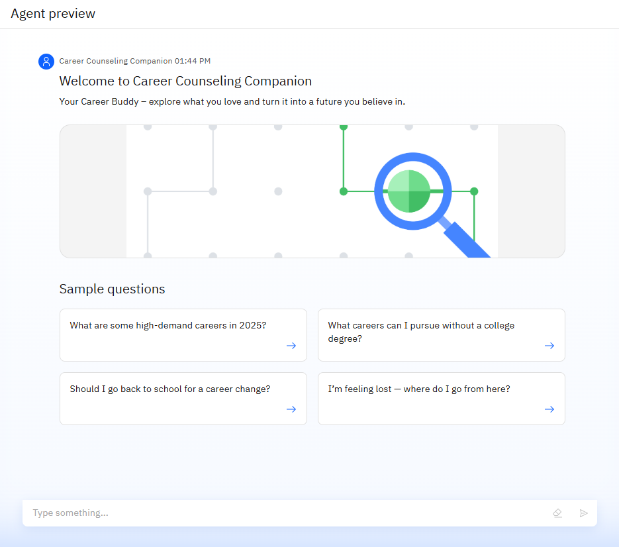
Results
This is a preview screen of the Career Counseling Companion, an AI-powered virtual advisor that helps users explore and plan career paths. The interface features a friendly welcome message and sample questions to guide users in asking about high-demand careers, career changes, or non-traditional paths. A clean layout with a search icon invites users to start chatting and get personalized guidance.

Slide 9
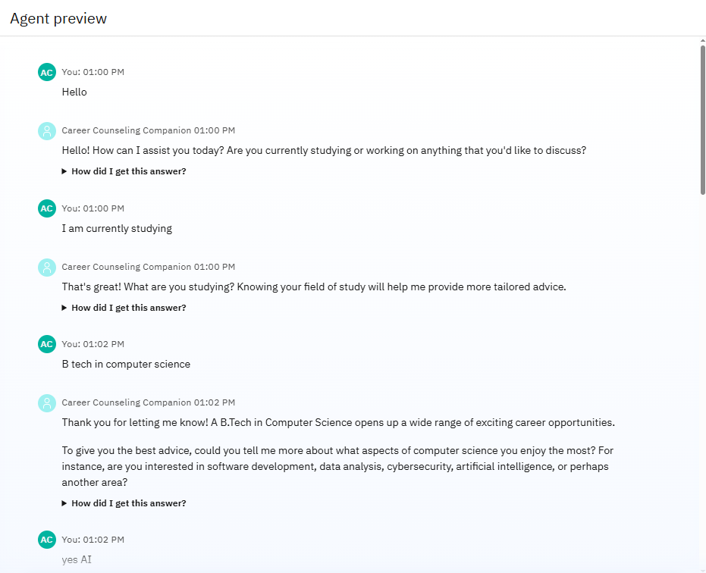
Results
This image shows a live conversation example between a student and the Career Counseling Companion. The AI begins by asking if the user is studying or working, then continues to narrow down the conversation based on the user's responses.

Slide 10
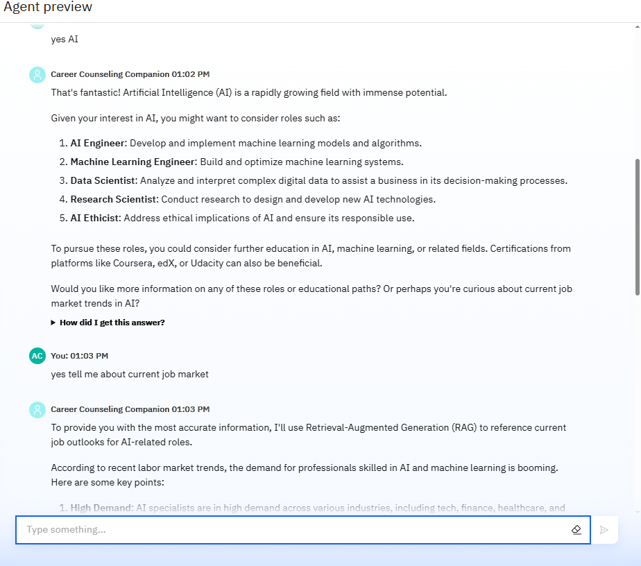
Results
This preview highlights how the AI delivers smart, personalized, and real-time guidance based on both user input and live industry data.

Slide 11
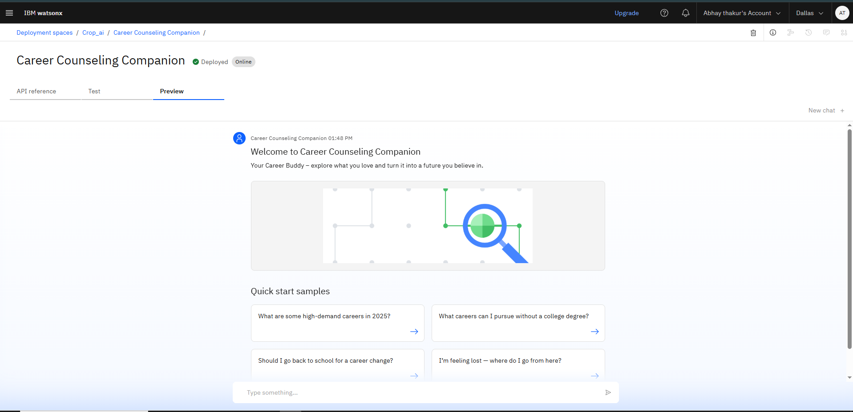
Results
Deployed AI Agent

Slide 12
Conclusion
The Career Counseling Companion AI is a powerful, student-centered virtual advisor designed to transform how learners plan their futures. By combining real-time labor market data, personalized insights, and respectful dialogue, this AI empowers students to make informed, confident career decisions. Whether they’re just beginning their journey or seeking a career shift, the assistant adapts to their goals, interests, and academic strengths—guiding them step by step toward a fulfilling and future-ready path. It’s not just a tool, but a trusted career buddy for every student.

Slide 13
GitHub Link
https://github.com/AbhaySinghThakur271/Career-Counseling-Companion-AI-agent

Slide 14
Future scope
Integration with Academic Portals
Voice-Activated Research Assistant
Support multiple languages and adapt to regional career trends and education systems.
Offer hybrid support by integrating AI suggestions with live counselor feedback for complex queries.
Notify students about entrance exams, scholarships, deadlines, and eligibility criteria.
Launch as an Android/iOS app for easier student access anytime, anywhere.

Slide 15
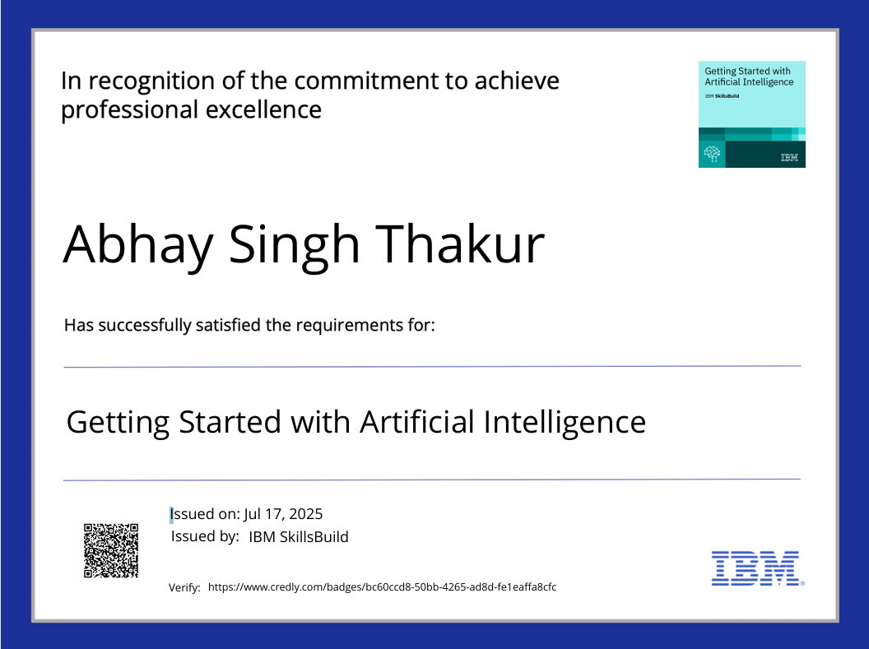
IBM Certifications

Slide 16
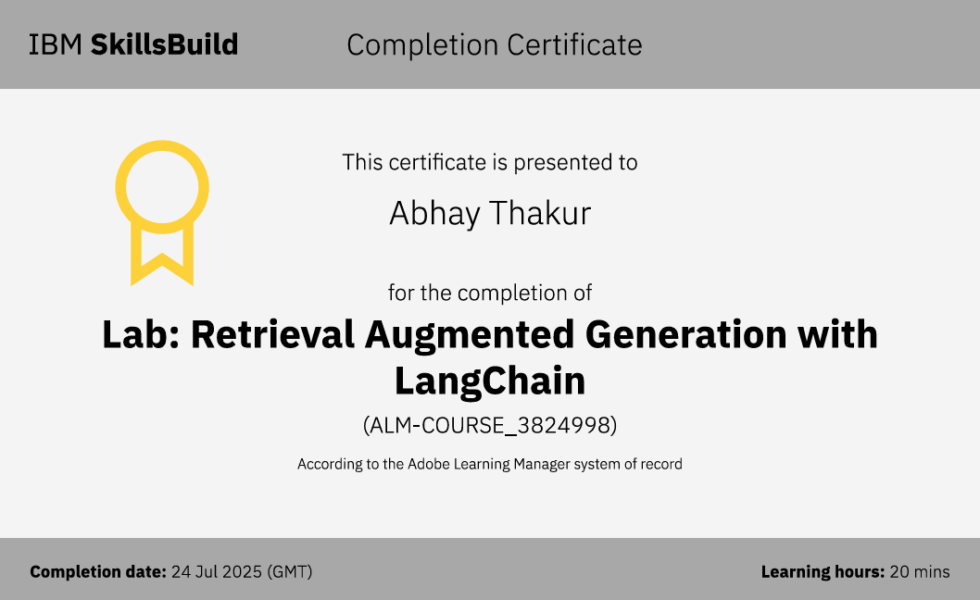

Slide 17
THANK YOU

